Slide 1


Solid Waste management Group
Proposed CCNY Expansion
Jubair Uddin
Sebastian Tinazzi
Benjamin Conable
Ksenia Shikhmacheva
CE 372
Professor Beth Wittig

Slide 2
Outline
ObjectiveS
Estimate existing and build condition solid waste generation for the project
Compare it with the standards set out for solid waste management in the CEQR Technical Manual
Determine if the proposed project will have a significant adverse impact
Make Recommendation to approve or reject
Introduction
Existing Residential Solid Waste
Existing Commercial Solid Waste
Project Municipal Solid Waste
Impact on MSW Infrastructure
Mitigation, Conclusion and Recommendation

Slide 3

Introduction
The property for this report is the volume of municipal solid waste disposed of within the development area in existing and build conditions.
The threshold for significant adverse impact is an additional 50 tons/week MSW.
The study area is set at the edges of the project as MSW generation outside the area is not expected to change.

Slide 4
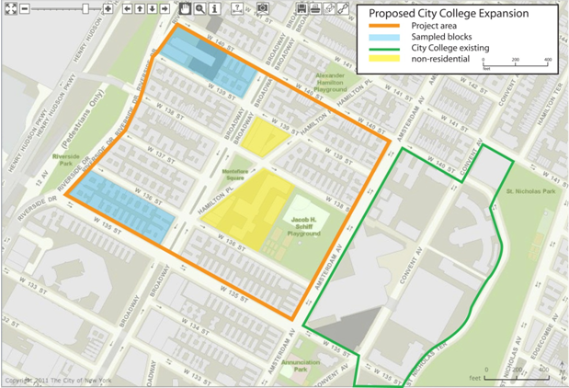

Existing Residential Solid Waste
$$U_{B}×B=U_{T}$$
U_{B} is number of units in a sample block
B is the number of residential blocks in the study area
U_{T} is total units in study area
$$U_{T}×R_{U}×\frac{1ton}{2000lbs}=MSW_{ER}$$
MSW_{ER} is Municipal Solid Waste generated in tons per week by existing residential
R_{U} is MSW generation rate in pounds per unit per week based on Table 1.

Slide 5

Existing Residential Solid Waste
Rate= 41 pounds per unit per week per residential unit
$$\begin{matrix}\begin{aligned}464\frac{units}{block_{std}}×7blocks_{std}+920\frac{units}{block_{hd}}×1block_{hd} \\ =4168units\end{aligned} \\ \end{matrix}$$
$$4168units×41\frac{lbs}{week}×\frac{1ton}{2000lbs}=85.4\frac{tons}{week}$$
About 10 tons per city block per week
Method used previously at Manhattanville
Errors: estimation of residential units based from sample and estimate of MSW generation from Table 1

Slide 6
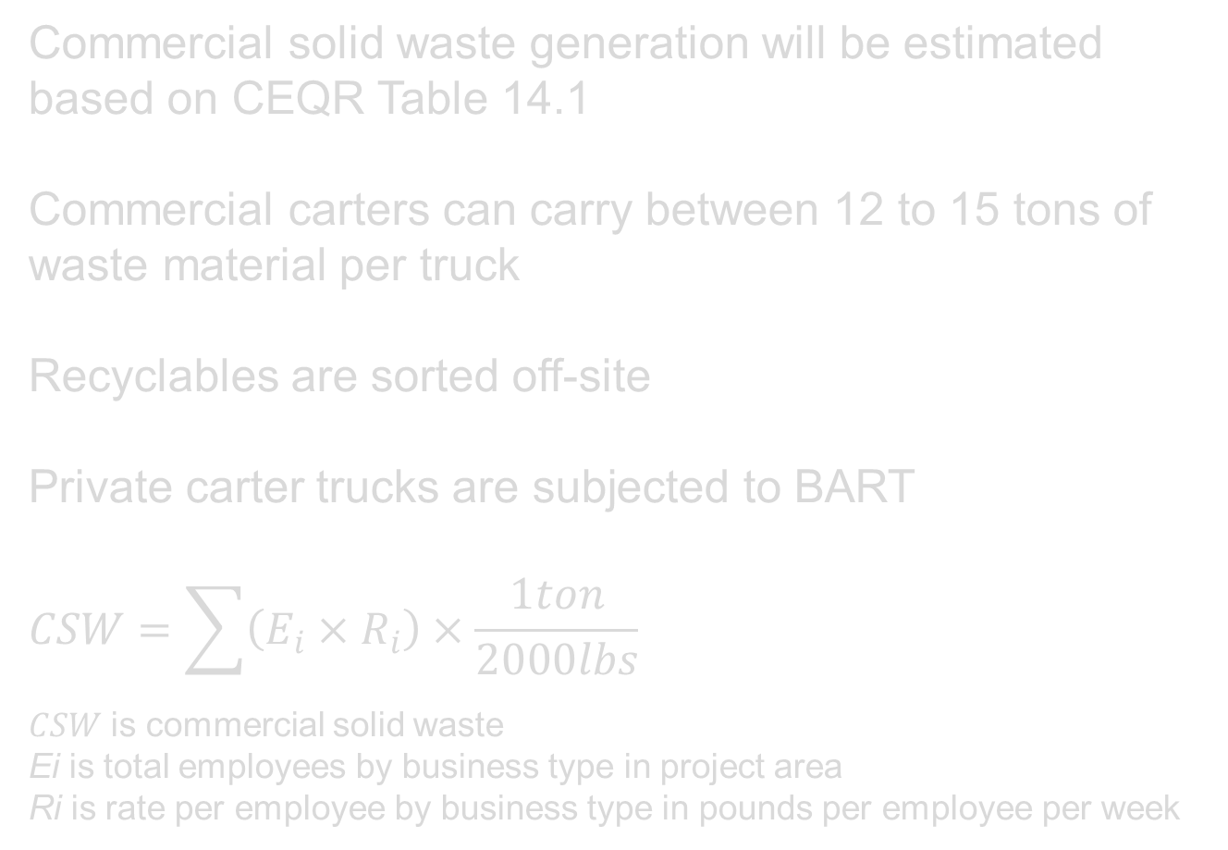
Existing COMMERCIAL SOLID WASTE
Commercial solid waste generation will be estimated based on CEQR Table 14.1
Commercial carters can carry between 12 to 15 tons of waste material per truck
Recyclables are sorted off-site
Private carter trucks are subjected to BART
$$CSW=\sum{\left(E_{i}×R_{i}\right)}×\frac{1ton}{2000lbs}$$
$CSW$ is commercial solid waste
Ei is total employees by business type in project area
Ri is rate per employee by business type in pounds per employee per week

Slide 7
Existing COMMERCIAL SOLID WASTE
USE | Businesses | Employees | Rate (lbs/Emp) | Total MSW
OFFICE | 22 | 42 | 9 | 378
OFFICE BLDG. | 14 | 108 | 13 | 1404
ELEM. SCHOOL | 1 | 571 | 4 | 2284
WHOLESALE | 1 | 4 | 66 | 264
GEN. RETAIL | 46 | 141 | 79 | 11139
FOOD STORE | 25 | 146 | 284 | 41464
FAST FOOD | 7 | 43 | 200 | 8600
RESTAURANT | 12 | 53 | 251 | 13303
Total |  | 1108 |  | 78836
Total MSW |  | 78836 | lbs/wk
 |  | 39.42 | Tons/wk
 |  | 35.75 | MT/wk

Slide 8
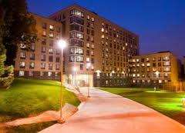
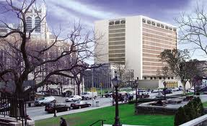
Build Municipal SOLID WASTE
http://aschacterlaw.com/practice-areas/
Type of Waste | Amount (T/week)
MSW residential | 15
MSW college | 27.9
MSW food | 0.3
Total | 43.2
http://archpaper.com/news/articles.asp?id=4865

Slide 9
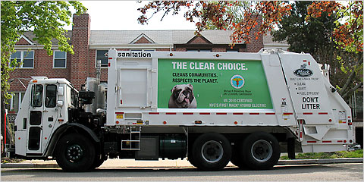


MUNICIPAL SOLID WASTE COLLECTION
  $\overline{\left(\frac{{MSW_{ER}}/{3\frac{p−ups}{wk}}}{Cap_{DSNY}}\right)}×3\frac{p−ups}{wk}=\frac{Trucks}{wk}$
$\overline{\left(\frac{MSW_{P}}{Cap_{DSNY}}\right)}=\frac{Trucks}{wk}$ Total project trucks per week
$MSW_{P}$ = Project Municipal Solid Waste (tons/wk)
${MSW}_{ER}$ = Residential MSW (tons/wk)
$CSW$ = Commercial Solid Waste (tons/wk)
$Cap_{type}$ = Truck Capacity (tons/wk)
+ $\overline{\left(\frac{CSW}{Cap_{CT}}\right)}=\frac{Trucks}{wk}$ }
Total Existing trucks
per week

Slide 10
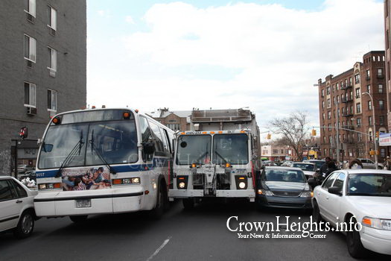
MUNICIPAL SOLID WASTE COLLECTION
Consolidation of Municipal Solid Waste collection reduces impact on MSW infrastructure and improves traffic, noise and air quality.
CONDITION | MSWr (tons) | MSWc (tons) | MSWt (tons) | TRUCKS (week⁻¹) | STOPS (week⁻¹)
Existing | 85.4 | 39 | 124.4 | 12 | 1310
Build | 15 | 28.2 | 43.2 | 5 | 30
% Change | -82.4 | -27.7 | -65.2 | -58.3 | -97.7

Slide 11
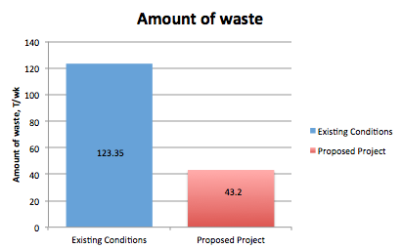
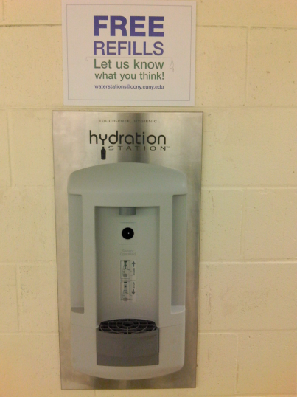

CONCLUSION
Proposed project decreases the amount of SW by 65%
Decreases impact on DSMW infrastructure
Recommend to approve the project
T/wk
T/wk
MITIGATION
Extensive Recycling
Using Only Air-Dryers
Water Coolers On Each Floor
Kitchen Garbage Disposal
On-site Composting
http://www1.ccny.cuny.edu/facultystaff/ccnygreen/
http://environmentalcrime.com/Composting.html

Slide 12
References
City of New York (2011). “NYC Compost Project.” City of New York, <http://www.nyc.gov/html/nycwasteless/html/compost/compostproj.shtml> (February 25, 2011).
CrownHeights.info (2009). “3 Vehicle Accident on Troy and Empire.” <http://www.crownheights.info/index.php?itemid=17047>
Editor_CM (2011) “Qatar aims at 38% waste recycle capacity by 2016.” <http://www.qatarisbooming.com/2011/05/05/qatar-aims-at-38-waste-recycle-capacity-by-2016/> (April 15, 2011)
Environmental Protection Agency (2011). Environmental Protection Agency, <http://www.epa.gov/visibility/fs_2005_6_15.html.>
“Filtered Water Now on Tap in Marshak.”the City College of New York, <www1.ccny.cuny.edu/facultystaff/ccnygreen/>
Justa, Aditi (2009) “Garbage trucks in New York city save on fuel and give a green message.” http://www.greendiary.com/entry/garbage-trucks-in-new-york-city-save-on-fuel-and-give-a-green-message/
SSL industries,<http://www.sslind.com/links.html> (April 15, 2011)

Slide 13
Appendix A: Commercial solid waste generation data, business survey
Benjamin Conable
USE | RATE | # of BUSINESSES |  |  |  | EMPLOYEES | TOTAL MSW
Office Building | 13 | 3 |  |  |  | 35 | 455 |  |  | 25 med emp.
Single Offices | 9 | 4 |  |  |  | 15 | 135
Wholesale | 66 | 1 |  |  |  | 4 | 264
General Retail | 79 | 9 |  |  |  | 29 | 2291
Restaurants | 251 | 1 |  |  |  | 6 | 1506
Fast Food | 200 | 3 |  |  |  | 28 | 5600
Food Stores | 284 | 6 |  |  |  | 66 | 18744
Total |  | 27 |  |  |  |  | 28995
JUBAIR UDDIN
Business Classification | Rate | Total Businesses |  |  |  | Employees | Total MSW
GENERAL REAIL STORE | 79 | 15 |  |  |  | 40 | 3160
RESTURAUNTS | 251 | 4 |  |  |  | 15 | 3765
FAST FOOD | 200 | 2 |  |  |  | 5 | 1000
FOOD STORE | 284 | 7 |  |  |  | 19 | 5396
SINGLE OFFICES | 9 | 4 |  |  |  | 12 | 108
OFFICE BUIDLING | 13 | 2 |  |  |  | 13 | 169 |  |  | 13 med emp
Total |  | 34 |  |  |  |  | 13598
Sebastian Tinazzi
USE | RATE | Total Employee |  |  |  | Total MSW
Office Building | 13 | 15 |  |  |  | 195 |  |  |  | 19 med emp.
Single Offices | 9 | 4 |  |  |  | 36
General Retail | 79 | 49 |  |  |  | 3871
Restaurants | 251 | 26 |  |  |  | 6526
Fast Food | 200 | 4 |  |  |  | 800
Food Stores | 284 | 36 |  |  |  | 10224
Elem. School | 4 | 571 |  |  |  | 2284
48 |  |  |  |  |  | 23936
Ksenia Shikhmacheva
USE | RATE | Total Employee |  |  |  | Total MSW
Office Building | 13 | 45 |  |  |  | 585 |  |  | 40 med emp.
Single Offices | 9 | 11 |  |  |  | 99
General Retail | 79 | 23 |  |  |  | 1817
Restaurants | 251 | 6 |  |  |  | 1506
Fast Food | 200 | 6 |  |  |  | 1200
Food Stores | 284 | 25 |  |  |  | 7100
 |  |  |  |  |  | 12307

Slide 14
Appendix B: Solid Waste Group meeting minutes
First Meeting on 02/09/2011
8.30 AM - 9.15AM
The meeting was called by Sebastian to meet on Wednesday, February 9th, 2011 at 8.30 AM in the classroom. The following persons were present on the meeting: Sebastian Tinazzi, Ksenia Shikhmacheva and Benjamin Conable. Jubair Uddin was absent. The meeting lasted 45 minutes. Minutes were taken and submitted by Ksenia Shikhmacheva.
At the beginning of the meeting, the roles were defined as
Sebastian Tinazzi – Project Manager;
Benjamin Conable – Time Keeper;
Ksenia Shikhmacheva – Note Taker.
Exchange of personal information
Sebastian Tinazzi (718)877-4630 satf10@hotmail.com
Benjamin Conable (917)449-0415 benconable@mindspring.com
Ksenia Shikhamcheva (646)334-3399 ks.shik@gmail.com
Rewiew IW1
Reading printed individual works. Sebastian expressed the difficulty of writing the first assignment. Ben gave him a feedback, pointing on concentrating on the specific topic. Giving feedback to Ben’s and Ksenia’s papers. Discussing Jubair’s work.
• Discussion
Defying the object of the project in more specific terms.
Deciding to work on the project in “real time” - writing the parts of it during the semester, not leaving to the end.
Ben formulated “special waste” issue
Sebastian proposed some improvements to reduce solid waste which should be in the paper (for example, more hand dryers in the bathrooms).
Ben discussed the food waste from private vendors.
Ksenia suggested proposing a composting area in the project.
Ben considered solid waste management for Towers.

Slide 15
Agenda for the second meeting
It was decided the second meeting will take place on Wednesday, February 16th, 2011 at 8.30AM. All members will be reminded personally and via email.
Review comments for IW2 of each group member.
Discussing final version for Objective and Introduction parts.
Discussing the ways of proceeding experiments relative to the project (what is important, which data can be collected, how to analyze it).
Preparing questions to ask Professor Wittig in class.
At the next meeting, the roles will be assigned as following:
Benjamin Conable – Facilitator;
Sebastian Tinazzi – Note taker;
Ksenia Shikhmacheva– Project Manager;
Jubair Uddin – Time keeper.

Slide 16
Second Meeting on 03/03/2011
12.30 PM - 1.30 PM
The meeting was called by the whole team to meet on Thursday, March 3rd, 2011 at 12.30 PM in the library of Marshak Science Building. Every member of the team was present and on time. The meeting lasted 60 minutes. Minutes were taken and submitted by Jubair Uddin.
At the beginning of the meeting, the roles were defined as
Sebastian Tinazzi – Note taker;
Benjamin Conable – Facilitator;
Ksenia Shikhmacheva – Team Leader;
Jubair Uddin – Time keeper.
Agenda
Review comments for IW2 of each group member.
Discussing final version for Objective and Introduction parts.
Discussing the ways of proceeding experiments relative to the project (what is important, which data can be collected, how to analyze it).
Preparing questions to ask Professor Wittig in class.
Rewiew IW2
Reading printed individual works. Benjamin discussed how he thought that the way he layout out his assignment was not as “clean” as the other team members. The team discussed for a few moments that Benjamin’s part was similar to our third individual assignment than our second assignment. Sebastian and Ksenia asked Benjamin about the number of students that was chosen for Marshak building. Benjamin explained that even though that number didn’t resemble the number of occupancy (number used was enrollment of semester) of the building, that number was the “highest” number possible for the building and it didn’t exceed the threshold value of 50 tons/week of solid waste. The different calculations done by each member were checked and Sebastian expressed that he thought that his numbers were too big. Benjamin and Ksenia explained that the squared footage used was the wrong one. Ksenia asked Jubair why did he separated students into different categories (grad, part time, full time), Jubair explained that he didn’t realized that the calculation was already done in the DEIS. Ksenia mentioned that the assumption by Benjamin that net waste from the proposed project will not be zero but it will be much more less for our project since the commercial waste will be gone.
Discussion
Defying the area of the project in more specific zones.
Deciding to work divided new area into four sub-zones and assigning one to each team member.
Ksenia formulated a table for data collection.
Benjamin discussed florescent tubes once more and mentioned that he was about to finished his analysis and was going to provide the data in the next meeting.
Sebastian wonder if the swimming pool was going to cause any waste, the team decided that it wasn’t relevant.
It was decided that the survey to collect data it’s going to be part of the appendix.

Slide 17
Agenda for the third meeting
It was decided that the third meeting will take place on Thursday, March 17th, 2011 at 12.30 PM. All members will be reminded personally and via email.
Review comments for IW3 of each group member.
Discussing data collection collected.
Discussing who will do what for the analysis (analysis, assess significance, identify mitigation).
Preparing questions to ask Pr Wittig in class.
At the next meeting, the roles will be assigned as following:
Benjamin Conable – Note taker;
Sebastian Tinazzi – Time keeper;
Ksenia Shikhmacheva – Facilitator;
Jubair Uddin – Team leader.

Slide 18
Minutes of Meeting 3 on March 17, 2011
1:15 PM – 2:45 PM
Roles:
Jubair Uddin – Team leader. Not present.
Ksenia Shikhmacheva – Facilitator;
Benjamin Conable – Note taker;
Sebastian Tinazzi – Time keeper;
Next meeting roles are:
Benjamin Conable – Team Leader;
Sebastian Tinazzi – faciliator;
Jubair Uddin - note taker.
Ksenia Shikhmacheva – time keeper;
Agenda
Review comments for IW3 of each group member.
Discussing data collected.
Discussing who will do what for the analysis (analysis, assess significance, identify mitigation).
Discussion delayed until after meeting with professor.
Prepare questions to ask Professor Wittig
Set date and time and agenda for Group Meeting 4
For Monday, Jubair, team leader will compile raw data and write memo for submittal.
It was decided that due to Jubair being late, team leader responsibility will be shared by the remaining team for meeting 3.
The team briefly discussed IW3. It was noted that the team members had different interpretations of what the assignment was. It was decided to ask Professor Wittig to comment.
Raw data discussion:
The group discussed estimation of employees for companies who would not provide information. Group members counted visible employees for non-responsive companies. That was determined to be sufficient for the count. The group discussed how to count medical offices, which do not appear in Table 14-1 of CEQR. It was decided to ask Professor Wittig at the meeting with her at 2 PM.
Who will do what for analysis:
Ben, Seb, Jubair
Analysis of existing conditions and analysis of impact on MSW infrastructure.
Ben: impact on MSW infrastructure and florescent
Seb: residential
Jubair: commercial existing
Ksenia: Analysis of build condition - Identify mitigation

Slide 19
Questions and answers from meeting with Professor Wittig:
Our results for assess significance do not activate other parts of the chapter 14. We want to do the sections anyway. Is that a good thing for the project? Specifically…
500. mitigation
400 impact
312. detailed analysis
313. Most of the medical waste comes from the labs, not the clinic. No medical waste
320. swmp
- Prof. Wittig says yes do all sections and state that some sections would not be included in an actual DEIS and why.
Clarify the scope of the last two assignments specifically with reference to 14.
Professor Wittig says that IW2 was about identifying needed data and sources for it and IW3 was about formulating exact equations for analyzing data. Our team, especially Ben and Sebastian, made IW3 about MSW infrastructure impact and IW2 about existing conditions and build conditions analysis.
IW2 = what kind of data do we need. What sources of information do we need. Where is the data coming from.
IW3=what specific formulas and analysis is needed for all sections of ceqr.
May we divide report work as we feel is fair? Yes
How do we deal with medical offices which do not appear on Table 14-1?
Professor Wittig says to come up with a method for estimating MSW generation at a medical office, possibly by combining or considering Office Building, Hospital, and Retail rates. Provided the team comes up with reasonable justification, the method will be considered sound.
Wittig says project should really look like a lab report more than the CEQR 14. We can use CEQR 14 subheading in report. The person who writes analysis section for some specific data writes the method section as well, Wittig suggests. We can use our judgment regarding division of writing. Wittig says we should include a table that maps commercial store types to 14-1 table values.
Mitigation sections always end up being qualitative. –Wittig. Mitigation linked to existing usage. Ksenia asked questions about how aspirational our mitigations could be: whether we can include mitigations we would like to see or only mitigations that are existing at the college. Professor Wittig suggested that composting is relevant based on the presence of food service at the college.
Agenda GM4
Identify roles for final project – elect team leader
Review IW4
What still needs to be done – divide up the writing.
Further questions for Professor Wittig
Determine whether 5th meeting is necessary
Date for GM4: Thursday, March 31, 2011 at 12:30 PM.

Slide 20
Group Meeting 4
03/31/2011 1:30 PM – 2:30PM
Roles:
Benjamin Conable – Team Leader;
Sebastian Tinazzi – faciliator;
Jubair Uddin - note taker.
Ksenia Shikhmacheva – time keeper;
Today’s meeting discussions
Every group member will write two power point slides
The back ground picture, a classic photo from 2010 photo album was anonymously selected by
everyone in the group
Everyone has agreed to present their part of the project for the final presentation.
No further questions for Professor Wittig.
Next meeting date and time: Thursday April 14, 2011 @ 12:30
Roles for next meeting:
Team Leader (Final Project Manager) Benjamin Conable
Sebastian Tinazzi will organize the slides
Agenda for next meeting:
Discuss the details and specifics of the presentation
Discuss power point slide for the presentation
Discuss IW5

